Slide 1
CANCER SURVIVORSHIP OUTCOMES IN INDIVIDUALS WITH LUNG CANCER: AN ANALYSIS OF THE BEHAVIORAL RISK FACTOR SURVEILLANCE SYSTEM (BRFSS) DS 5100 GROUP PROJECT
Uyen Nguyen (gmd8sq) Andy Ortiz (eao7r) Lee Ann Johnson (lj6gd) JD Pinto (jp5ph)
Notes:
JD: Hi all. My name is JD Pinto and I have the pleasure of introducing our group project. The title of our project is Cancer Survivorship Outcomes in Individuals with Lung Cancer: An Analysis of the Behavioral Risk Factor Surveillance System. my fellow group members are Uyen Nguyen, Andy Ortiz, Lee Ann Johnson.

Slide 2
OVERVIEW
Introduction
Data Source
Data Cleaning
Data Analysis & Processing
Results
Testing
Conclusions
Notes:
Lee Ann: Today, we will present the details of our projects in each of these areas. The sample we chose were all individuals who identified themselves as having lung cancer. The responses we chose related to the outcomes of care.

Slide 3
INTRODUCTION
Lung cancer
235,760 new cases
131,880 new deaths
Survivorship begins at diagnosis
Relatively short survival after diagnosis
Know less about survivorship compared to other cancers
Notes:
Lee Ann: Lung cancer is the third most commonly diagnosed cancer, behind breast cancer for women and prostate cancer for men. In the United States, it remains the leading cause of cancer related deaths. In general, individuals are considered cancer survivors from the time cancer is first diagnosed. For many lung cancer survivors, survivorship is an ongoing period of treatment that occurs throughout a relatively short survival trajectory. Because of this phenomenon, less is known about survivorship in lung cancer compared to other types of cancers.

Slide 4
RESEARCH QUESTIONS
The overall purpose of this project was to create predictive models to identify patient characteristics associated with guideline-concordant survivorship care.
In a nationally representative sample of individuals with lung cancer, we will:
Describe the demographics, physical, and mental health characteristics
Examine associations between demographics, physical, and mental health characteristics and the survivorship outcomes (cancer care summaries, written cancer care summaries, and health insurance coverage)
Model which demographic physical, and mental health characteristics predict survivorship outcomes
Notes:
Lee Ann: The purpose of this project was to create predictive models to identify patient characteristics associated with guideline-concordant survivorship care. To accomplish this task, we selected a nationally representative sample of individuals with lung cancer and used a combination of demographic, physical, and mental characteristics to create models of survivorship care.

Slide 5
DATA SOURCE
Behavioral Risk Factor Surveillance System (BRFSS)
Annual, telephone-based
50 states + territories
Topics covered
Preventative services
Health-related risk behaviors
Chronic health conditions
Published by the Centers for Disease Control (CDC)
https://www.cdc.gov/brfss/index.html
Notes:
Andy: Data for this project is from the Behavioral Risk Factor Surveillance System, frequently abbreviated as “BRFSS” data. This survey is conducted annually, by telephone, in all 50 states as well as U.S. territories. Only those over age 18 can participate. The primary purpose of the survey is to collect information on health in America. Extensive demographic information is collected on each participant as well as information about chronic health conditions, such as heart disease, health-related risk factors, such as smoking and alcohol use, and preventative health services, such as access to a primary care provider. Each year, the CDC publishes the results of the survey online and the questionnaires, data dictionary, and data are available and free for anyone to use and analyze.

Slide 6
DATA CLEANING: FIRST STEPS
Merged 5 years of data: 2016, 2017, 2018, 2019, 2020
Selected individuals with lung cancer
Reduced dataset from 280 columns to 18
14 predictors
4 response variables
Notes:
Andy: We selected five years of data, from 2016 to 2020, for our analysis. Only individuals who identified as having lung cancer were included in our sample. The survey contained a total of 280 variables, but for the purpose of our analysis, we reduced the number of variables to 18: 14 predictor variables that consisted of demographic, physical, and mental health characteristics and 4 response variables that pertained to cancer survivorship.

Slide 7
PREDICTOR VARIABLES
State of Residence
Sex
Age
Education level
Marital status
Employment status
Income level
Race
Mental health in previous 30 days
Physical health in previous 30 days
Activities of daily living in previous 30 days
Difficulty with cognition
Difficulty with mobility
Difficulty performing errands
Notes:
Andy: These are the predictor variables we initially considered.

Slide 8
RESPONSE VARIABLES
Written Summary (CRVSUM) | Did any doctor, nurse, or other health professional ever give you a written summary of all the cancer treatments that you received?
Routine Cancer Check-Up (CSRVRTRN) | Have you ever received instructions from a doctor, nurse, or other health professional about where you should return or who you should see for routine cancer check-ups after completing treatment for cancer?
Adequate Health Insurance Coverage (CSRVINSR) | With your most recent diagnosis of cancer, did you have health insurance that paid for all or part of your cancer treatment? (“Health insurance” also includes Medicare, Medicaid, or other types of state health programs.)
Cancer Pain (CSRVPAIN) | Do you currently have physical pain caused by your cancer or cancer treatment?
Notes:
Andy: These are the response variables we considered. They include receiving a written summary of cancer treatment, receiving instructions about returning for cancer-related check-ups, having insurance that covered at least some cancer treatment, and pain after a cancer diagnosis.

Slide 9
DATA CLEANING: FINAL STEPS
Identified missing data
After removal of missing data:
For 3 of the response variables, 498 rows were useful after removal of missing data
For 1 response variable, 697 rows were useful
Notes:
Andy: First we identified missing data in both the predictor and response variables.

Slide 10
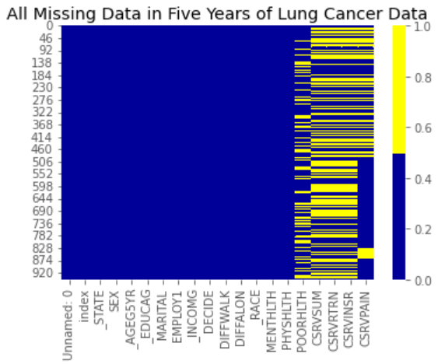
MISSING DATA VISUALIZATION
Notes:
Andy: Data was complete for predictor variables but the response variables had missing data. This is because each state decides which modules outside of the basic demographic questions, to administer, and not all states administered the module with the response variables we selected.

Slide 11
DATA ANALYSIS & PROCESSING
Visualizations of predictor variables
Visualizations of response variables
Logistic regression assumptions and tests
Logistic regression
Notes:
Uyen: Four steps were used to analyze and process the data. These included visualizing the predictor variables and response variables, choosing logistic regression assumptions and tests, and finally, conducting the logistic regression.

Slide 12
DATA ANALYSIS & PROCESSING
Predictor and response variables were explored
A selection of visuations will be presented for each type of variable
Notes:
Uyen: Though we performed a thorough visual exploration of both predictor and response variables, only a few of the visualizations will be presented today.

Slide 13
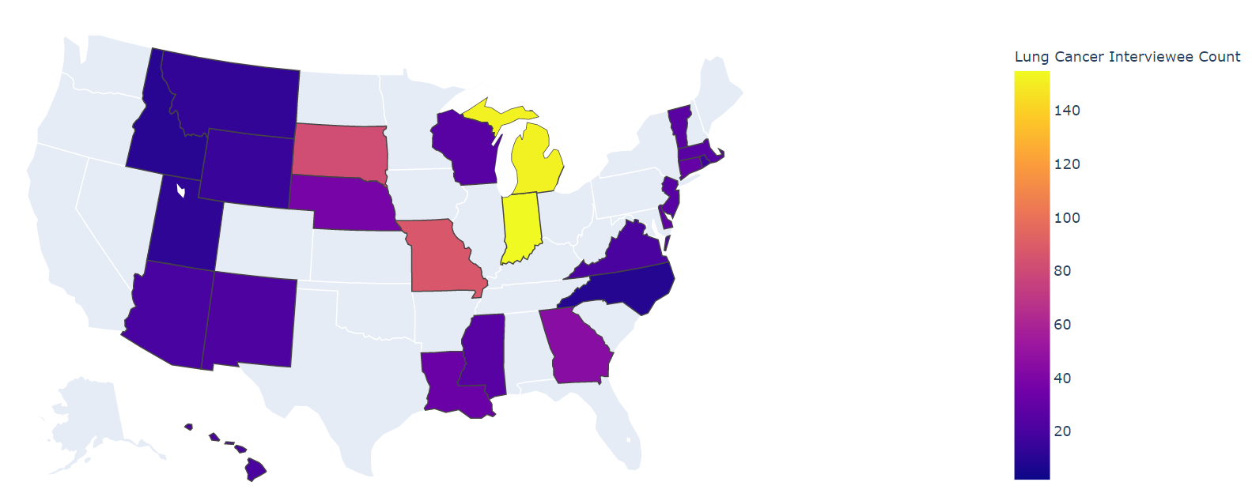
PREDICTOR: PARTICIPANTS BY STATE
Notes:
Uyen: We made an interactive graph to illustrate the counts of lung cancer in each state (Guam has 2 counts but not included on map). The state abbreviation and counts can be seen by hovering on the state when code is run. In our sample, there were more participants in Michigan and Indiana than in any other state.

Slide 14
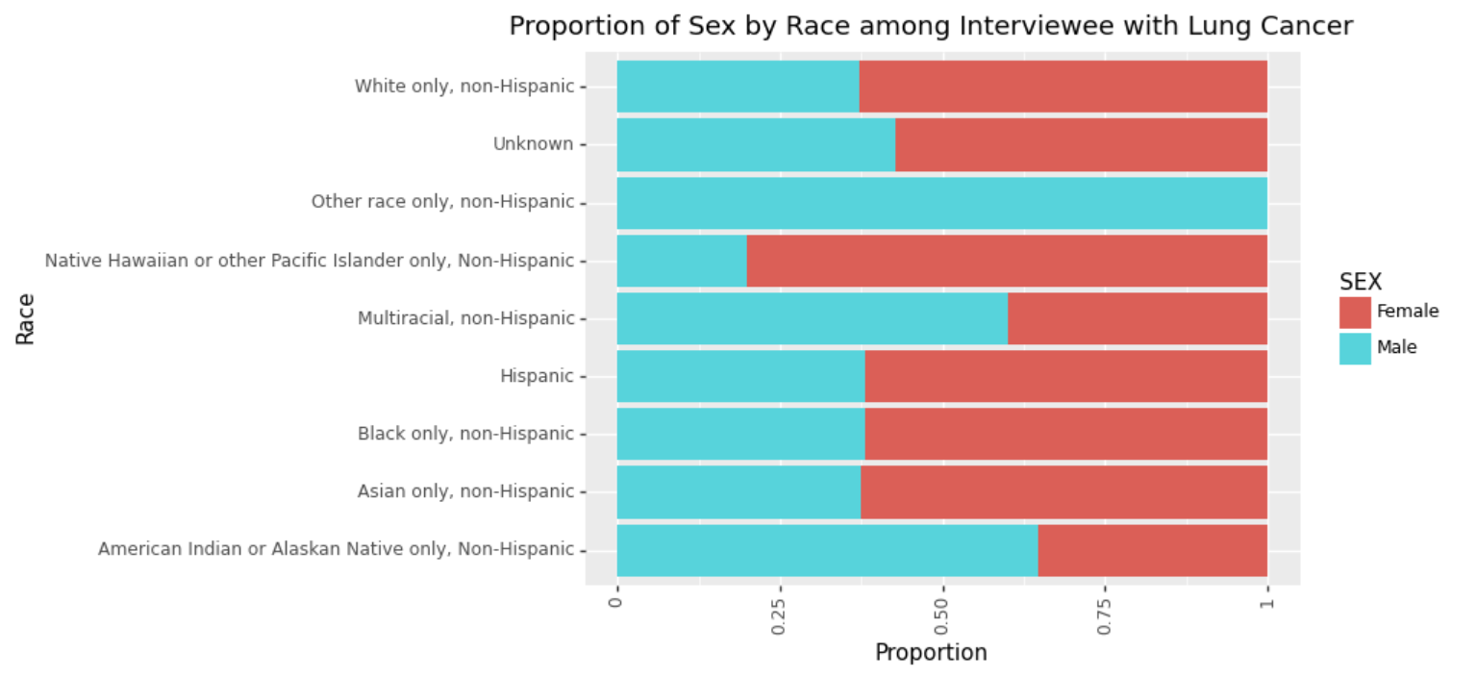
PREDICTOR: PARTICIPANTS BY SEX AND RACE
Notes:
Uyen: This table shows the proportion of men and women by race. In most racial categories, there were more women than men. Of note, more men identified as multi-racial and American Indian when compared to women.

Slide 15
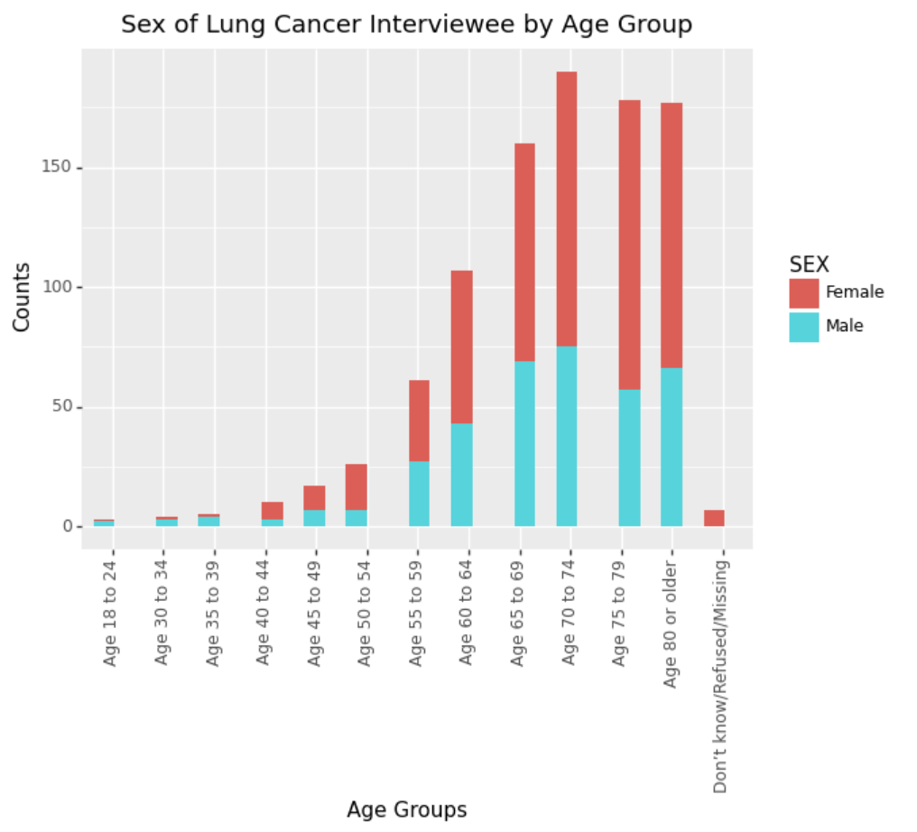
PREDICTOR: PARTICIPANTS BY AGE AND SEX
Notes:
Uyen: This table demonstrates the proportion of men and women by age category. Women are more likely to have lung cancer than men (source: https://healthcare.utah.edu/the-scope/shows.php?shows=0_ziut6aix) You can see from this table that the majority of participants were over age 60, which is typical of lung cancer. Most participants were between the ages of 70 and 74.

Slide 16
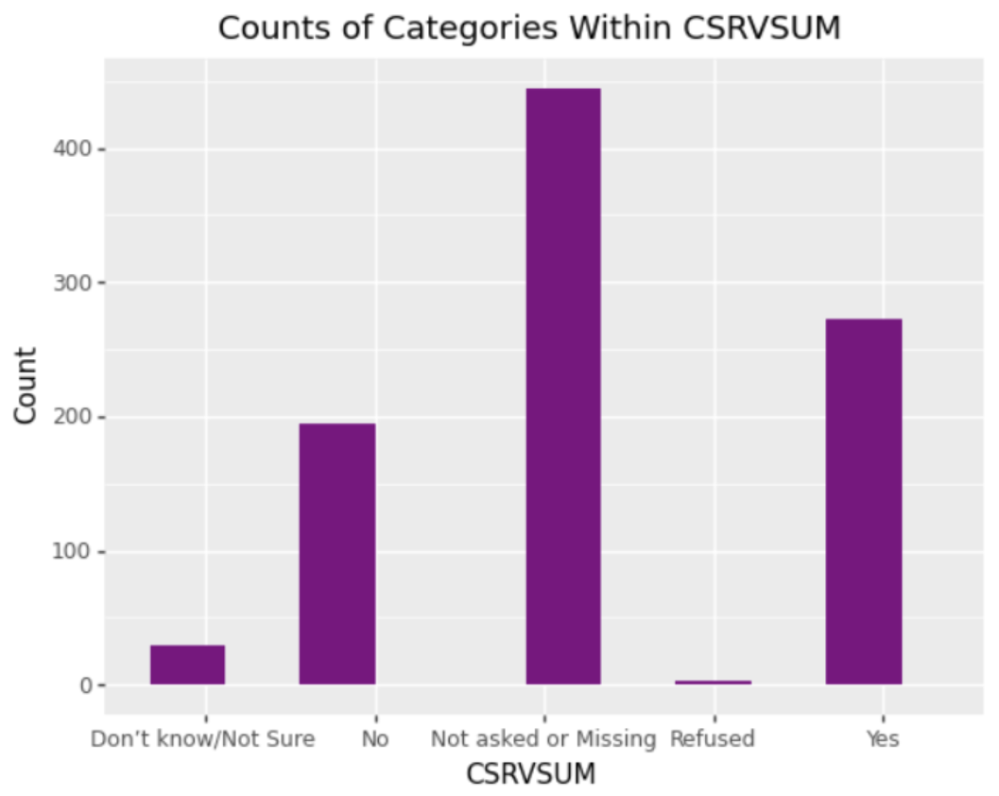
RESPONSE: CATEGORICAL RESPONSES FOR RECEIVING WRITTEN SUMMARY
Notes:
JD: The model we will present today used receiving a written summary as the outcome. This visual demonstrates that those who did and did not receive a summary were somewhat balanced.

Slide 17
RESULTS FROM LOGISTIC REGRESSIONS
Written Summary
Individuals with a college education are less likely to receive a written summary of cancer care.
Other variables were not significant within the model.
Notes:
JD: In our logistic regression with receiving a written summary of cancer care as the outcome, only level of education was significant in the overall model. We then created a model using only education, and found that those with a college education were less likely to receive a written summary.

Slide 18
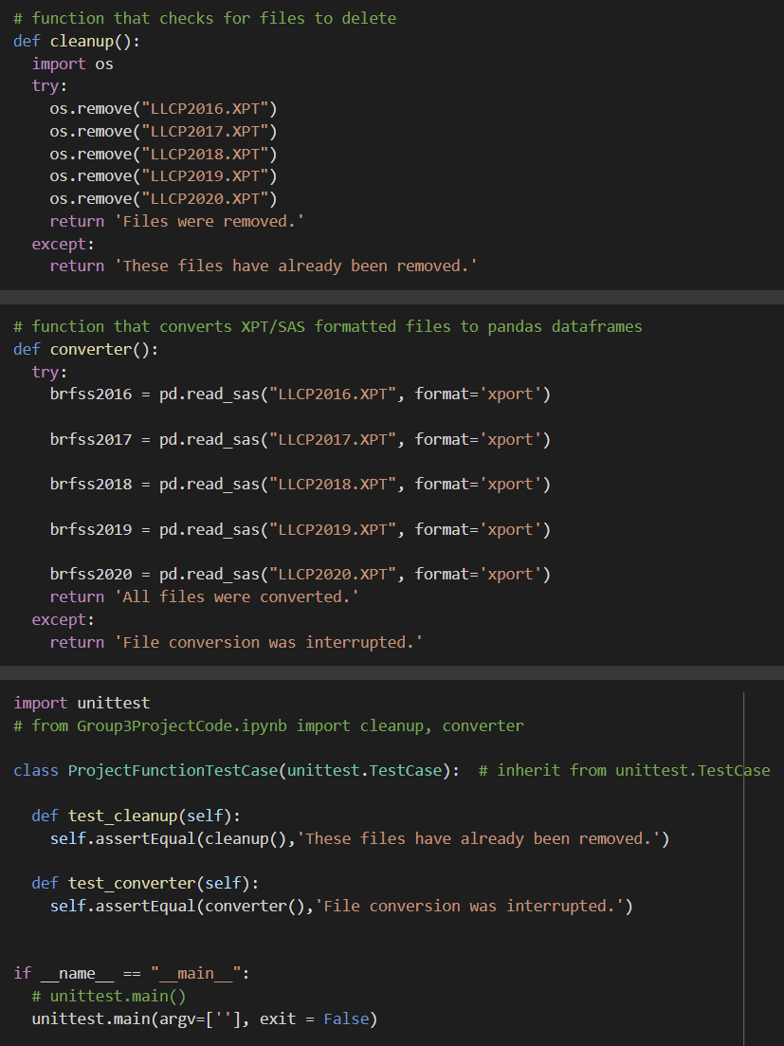
TESTING
Converting SAS files to pandas dataframe
Deleting unnecessary files
Notes:
JD: We created two unit tests. The first tested if the SAS files were correctly imported and converted to a dataframe that can be used with pandas. The second tested if un-needed large files existed. We ran the test and it returned OK without error.

Slide 19
CONCLUSIONS
Health-care providers should be more cognizant about providing written summaries to all individuals with lung cancer
We can improve by adding more interactivity with respect to survey by year
We can improve by adding more functionality that allows researchers to choose response variables and get results for each of them interactively
Notes:
Lee Ann: The significance of our findings is that providers who provide cancer care should ensure all individuals with lung cancer receive written materials, and this may include developing quality improvement projects around the process of providing written summaries. Functionality can be improved by adding interactivity with respect to survey by year and allowing users to select specific response variables to see outcomes.

Slide 20
THANK YOU FOR COMING TO OUR TED TALK

